Slide 1
Project 2 Zip Codes, Data Sources and Deadly Viruses
Group Members:
Tim Tang
Fred Tinio
Kevin Ewing
Laura De Morneau

Slide 2
Extract Process
Read data
We used several data sources to processes to cleanse and prep files in the following formats:
CSV files /.txt files / Spreadsheets
Data Sources
www.geonames.org (.txt converted to csv)
www.cdc.gov.gov/zika/reporting/index.html (.xls converted to csv)
www.census.gov/topics/health/birth-defects (csv file)

Slide 3
Transformation Process
Data cleaning
Manipulated data and used (states as primary id)
Used python / pandas / SQL Alchemy to cleanse data
Joining
Joined multiple data sources into one repository (SQL database)
Used mySQL workbench to set up and query data
Filtering
The filtering process consisted of filtering by date/time
Filtered by age
Filtered by zip code and aggregated by state
Summarization
The summarization process also consisted of taking multiple table sources and consolidating into one query

Slide 4
Load Process
Load process
The final load process consolidated multiple data sources into one central database
This database will be accessed by power users such as analysts, data scientists and executives to run various reports via multiple data management tools

Slide 5




Project 2 – ETL Process Flowchart
Extra Credit
Data
Transformation
Data Extract
Data Load
Presentation &
Visualization Layer
External Sources
Insights and
Management Tools
SAS
IBM Cognos
External & Legacy Information Sources
www.geonames.org
Pandas
Jupyter Notebook
MySQL
Brand
Touch Point
Daily
Automated
Reports
Touch Point Person
www.cdc.gov/zika
Database 1
Automation / Reporting
Field Marketer
Consumer
Analysts,
Data Scientists,
Executives
www.census.gov
Response Data
Device Data
Common End to End Audit and Validations

Slide 6
ETL Process Description
This entire ETL process was done to simplify day to day activities into one central repository for Analysts, Data Scientists and Executives to query data in one central location.
Each Extract-Transform-Load step was tested and validated to ensure data integrity and accuracy.

Slide 7
Appendix

Slide 8
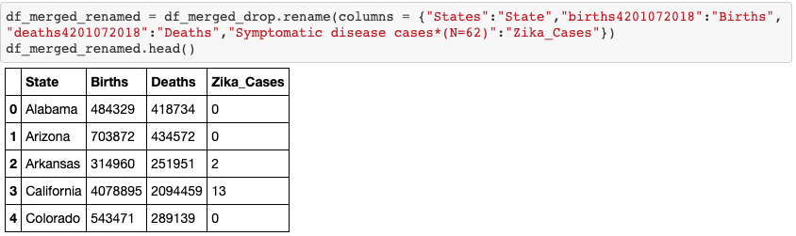
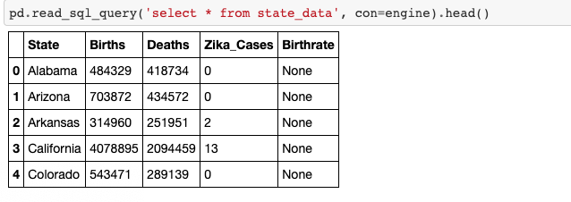

Slide 9
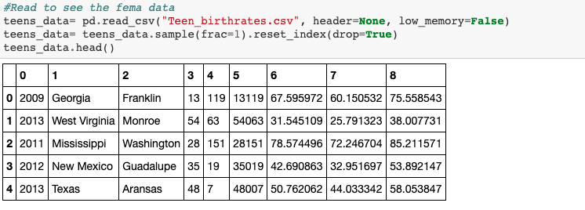
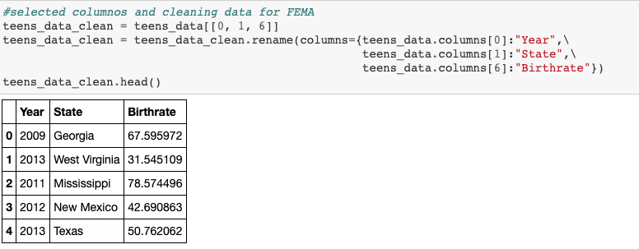

Slide 10
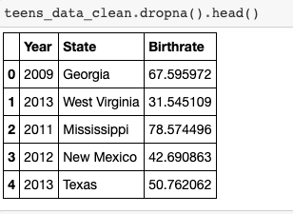
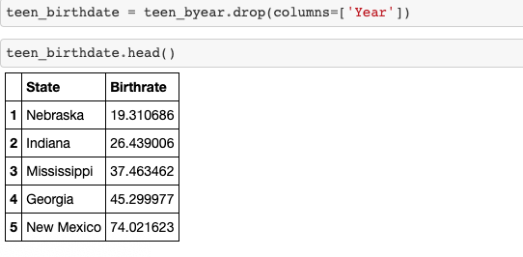

Slide 11
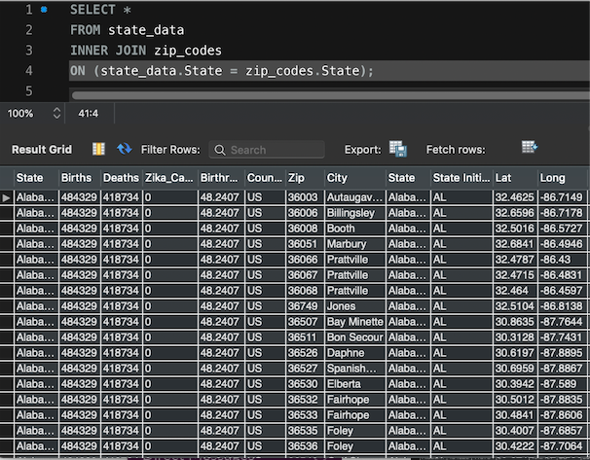

Slide 12
Daily Reporting Dashboard Snapshot
STATE | 2015 Zika Cases
California | 13
Puerto Rico | 10
Texas | 8
Florida | 6
Virginia | 5
District of Columbia | 4
Hawaii | 4
Massachusetts | 3
New York | 3
Arkansas | 2
Kentucky | 2
Maryland | 2
Minnesota | 2
Georgia | 1
Indiana | 1
Missouri | 1
New Hampshire | 1
New Jersey | 1
Pennsylvania | 1
Rhode Island | 1
Utah | 1

